Slide 1
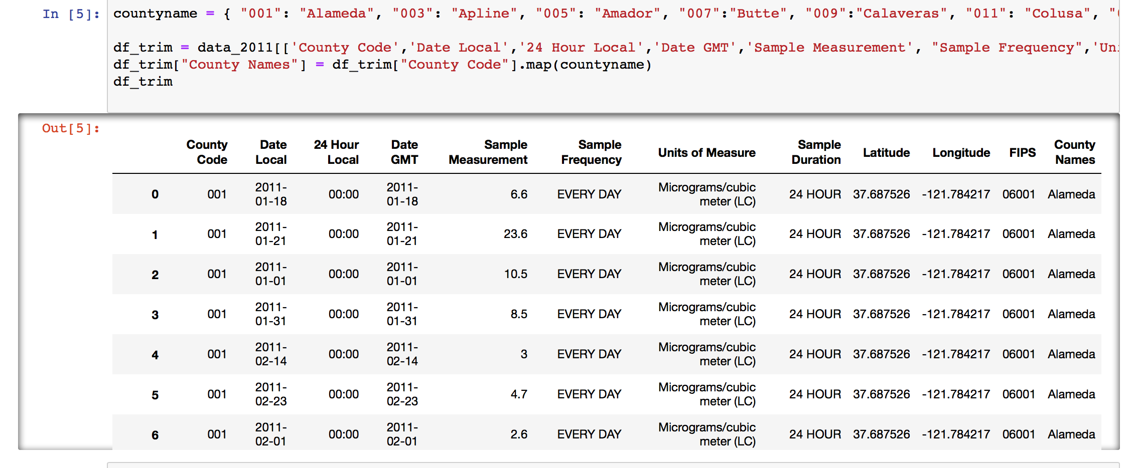
Data Cleaning: ☹
Created a dictionary with County Names and County Codes to map to new column in DataFrame.
And trimmed off non-essential columns.

Slide 2
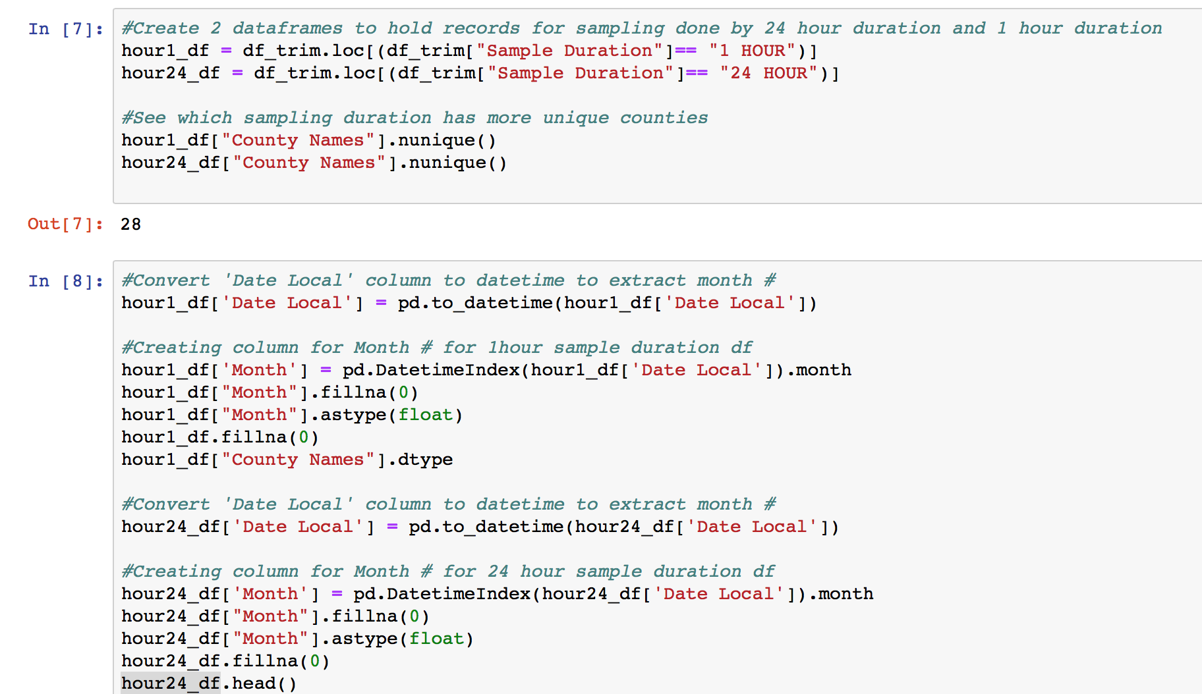
More Cleaning:
-Created 2 Data Frames to look at data gathered by “24 hour sampling” duration and “1 hour Sampling duration.
-Mapped month value from date column to separate column to analyze trends over the course of the year

Slide 3
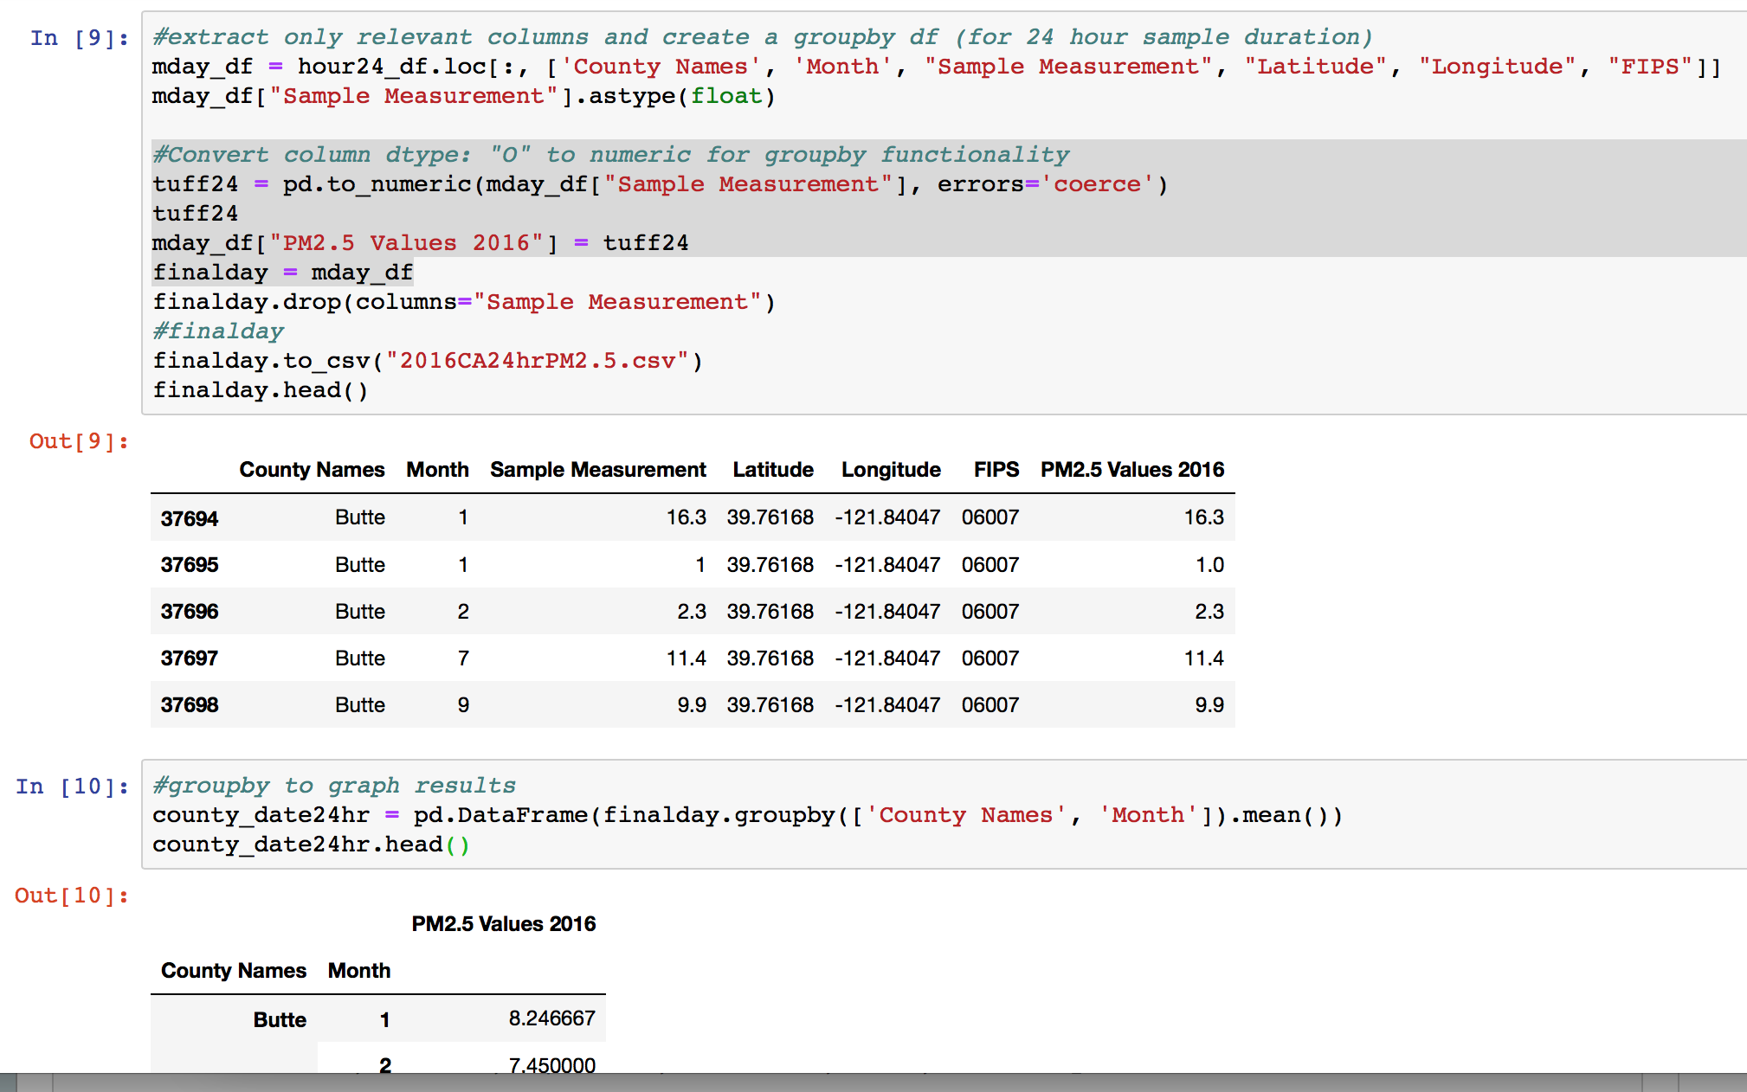
Limpiando Mas
Because “Sample Measurement” Data was returned from API as data type “O” or “Object, it had to be converted to float format in order to be used in “Groupby” function.
df[“column name”].dtype <= will return data type of column values
pd.to_numeric(df[“column name”], errors=“coerce”) <= will convert “obj” to numeric/float type
Than was able to groupby (“County Name” And “Month) to get PM2.5 AVG per month of each year.

Slide 4
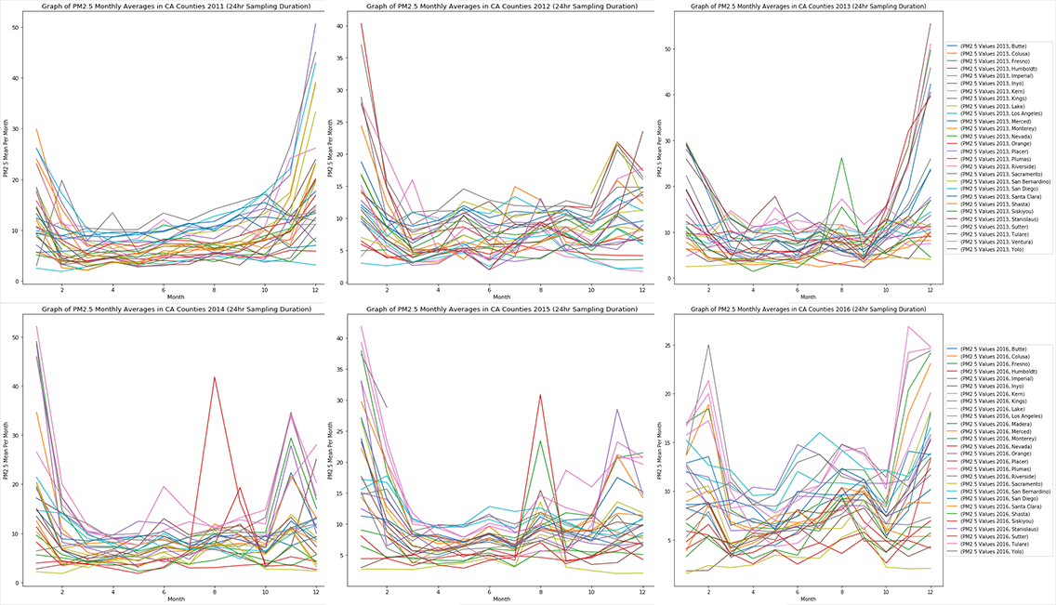

Slide 5
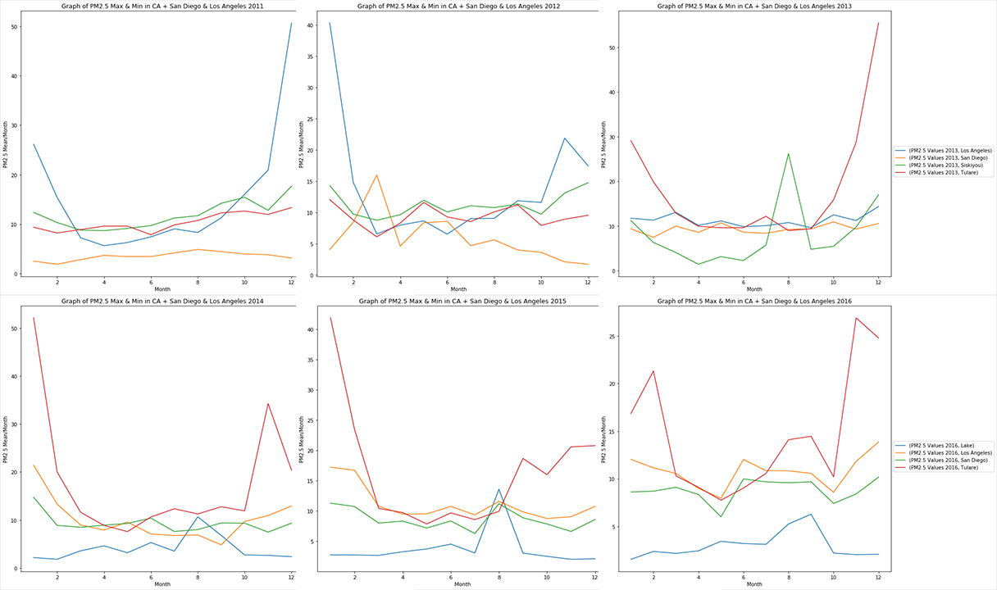

Slide 6
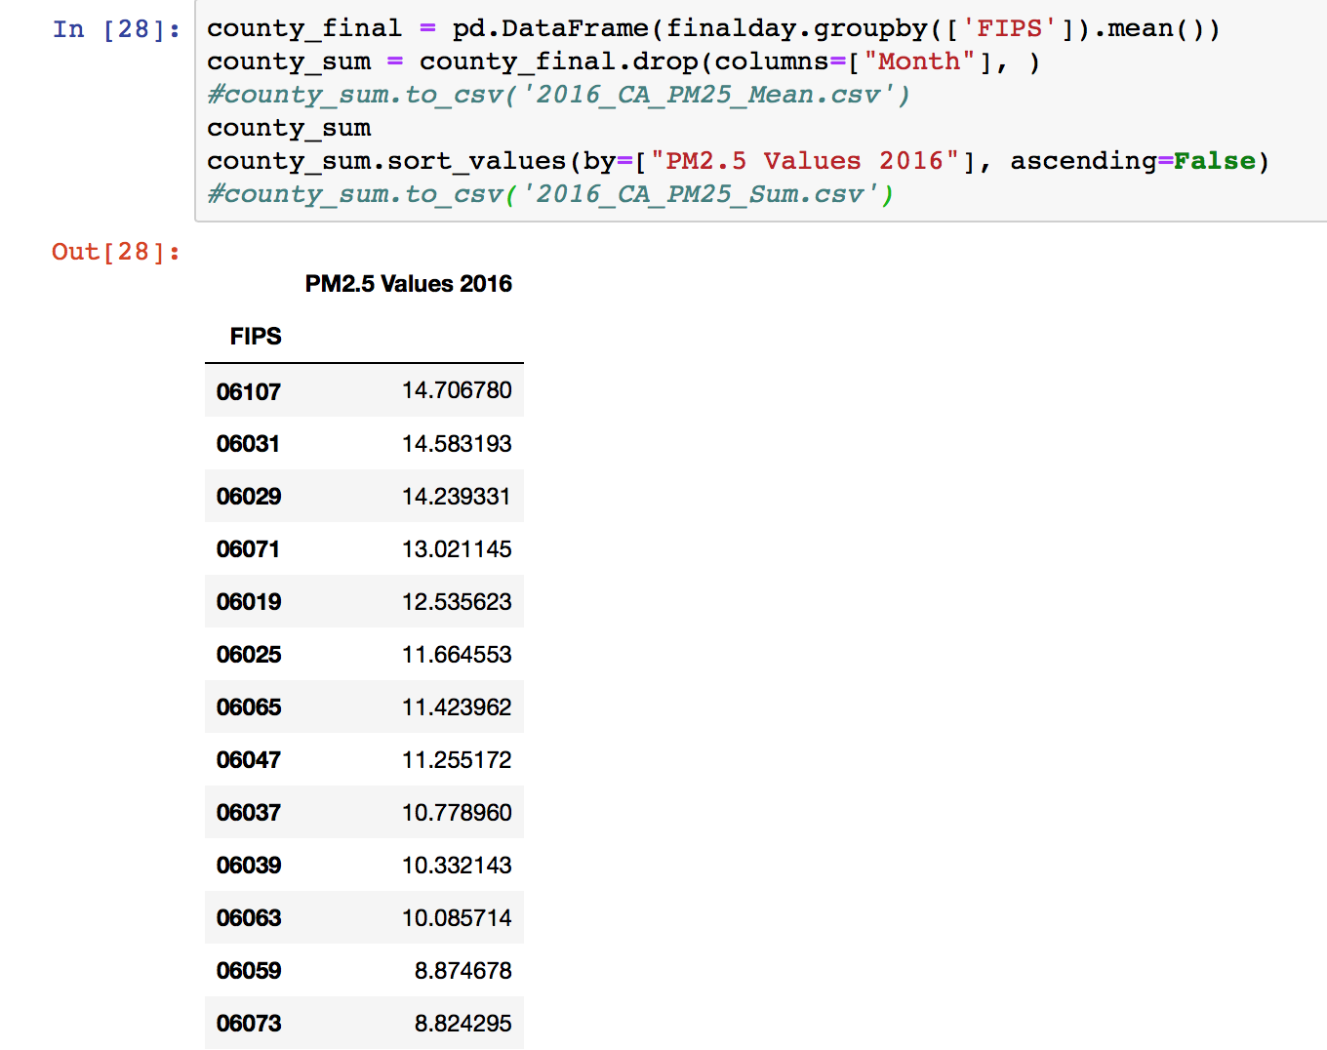
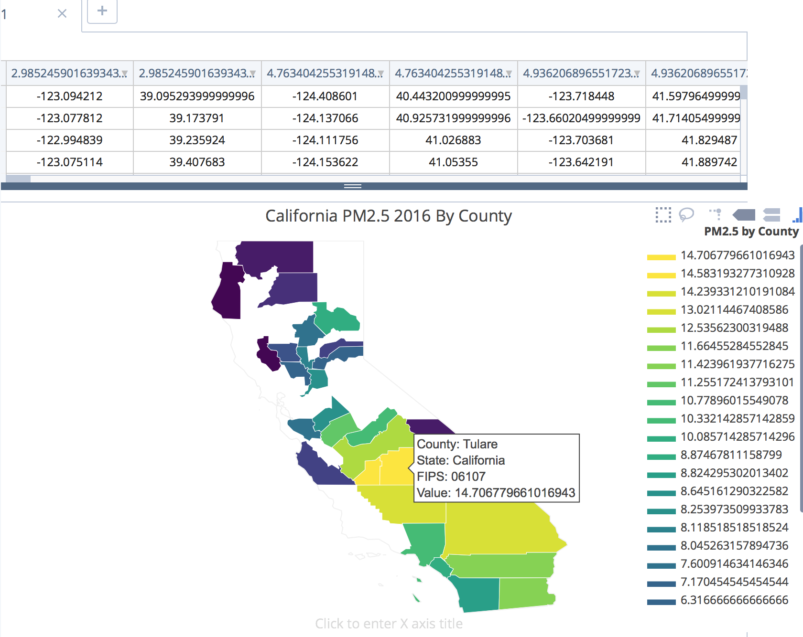
More Cleaning…
-Added California state FIPS code “06” to the front of the County code given from EPA API to make full FIPS code to graph with plot.ly

Slide 7
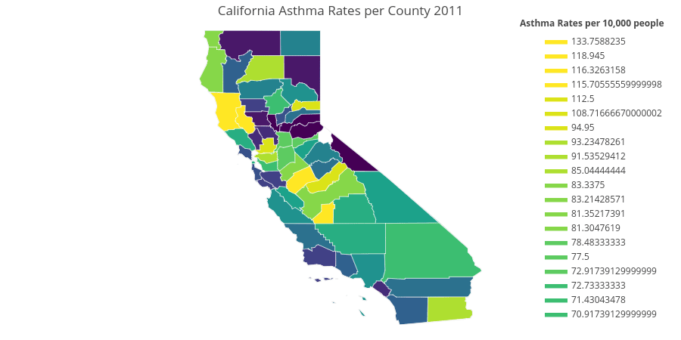
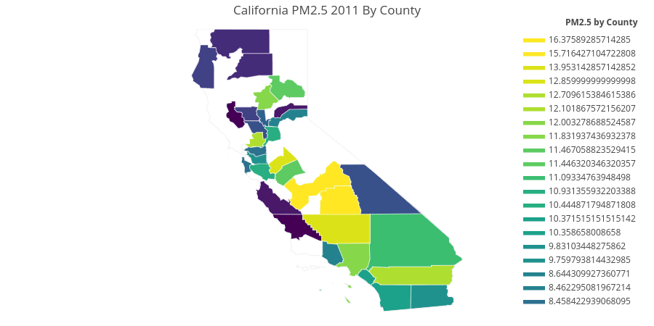
Summary for County PM2.5 visualization by county:
Stay away from: Kings County, Tulare, Kern County, Fresno, Merced if you have a respiratory sensitivity to pollutants.
We found a correlation between the amount of PM2.5 per county and the rate of Asthma Related hospital admissions in people under the age of 18.

Slide 8
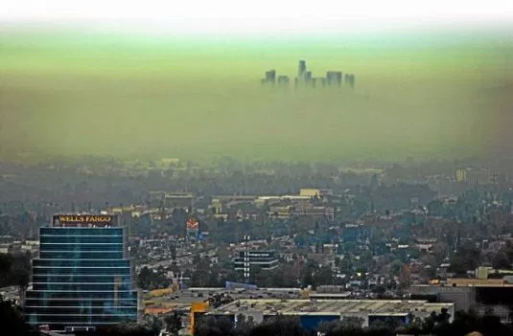
Hypothesis1: Ozone pollutions causes higher asthma rates..
Hypothesis 2: Particulate matter (PM2.5) is responsible for higher asthma rates.
UCSD Data visualization Bootcamp, DATA20180619
Notes:
Tropospheric ozone is a secondary pollutant, it is not emitted directly but instead is produced photochemically in the troposphere by its precursors such as reactive nitrogen oxide (NOx), CO, CH4 and VOC’s. Life time of an ozone molecule in the troposphere varies according to the photochemical activity ( a mean tropospheric life time is ~22days). Ozone has a longer life time in the free and cold troposphere than warmer boundary layer.
difference between stratospheric and tropospheric ozone generation is in the source of atomic O
for solar radiation with a wavelength of less than 242 nm:
O₂ + hv  O + O
photochemical production of O₃ in troposphere tied to NO_{x} (NO + NO₂)
for wavelengths less than 424 nm:
NO₂ + hv  NO + O
but NO will react with O₃
NO + O₃  NO₂
presence of peroxy radicals, from the oxidation of hydrocarbons, disturbs O₃-NO-NO₂ cycle
NO + HO₂·  NO₂ + OH·
NO + RO₂·  NO₂ + RO·
leads to net production of ozone
The ozone molecule has four resonance structure which imparts or confer a slight polarity to the ozone molecule (0.53D).
The bond length 1.272A is intermediate b/w double bond 1.21A and single bond (H-O) 1.47A {angstroms (A)}.
Protective shield in the stratosphere
Strong oxidant
Secondary pollutant in the troposphere
3rd most abundant GHG with RF +0.3 W.m-2
Damage crops and property
Cause respiratory diseases and premature mortality

Slide 9
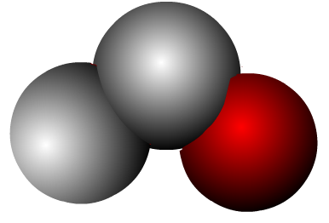
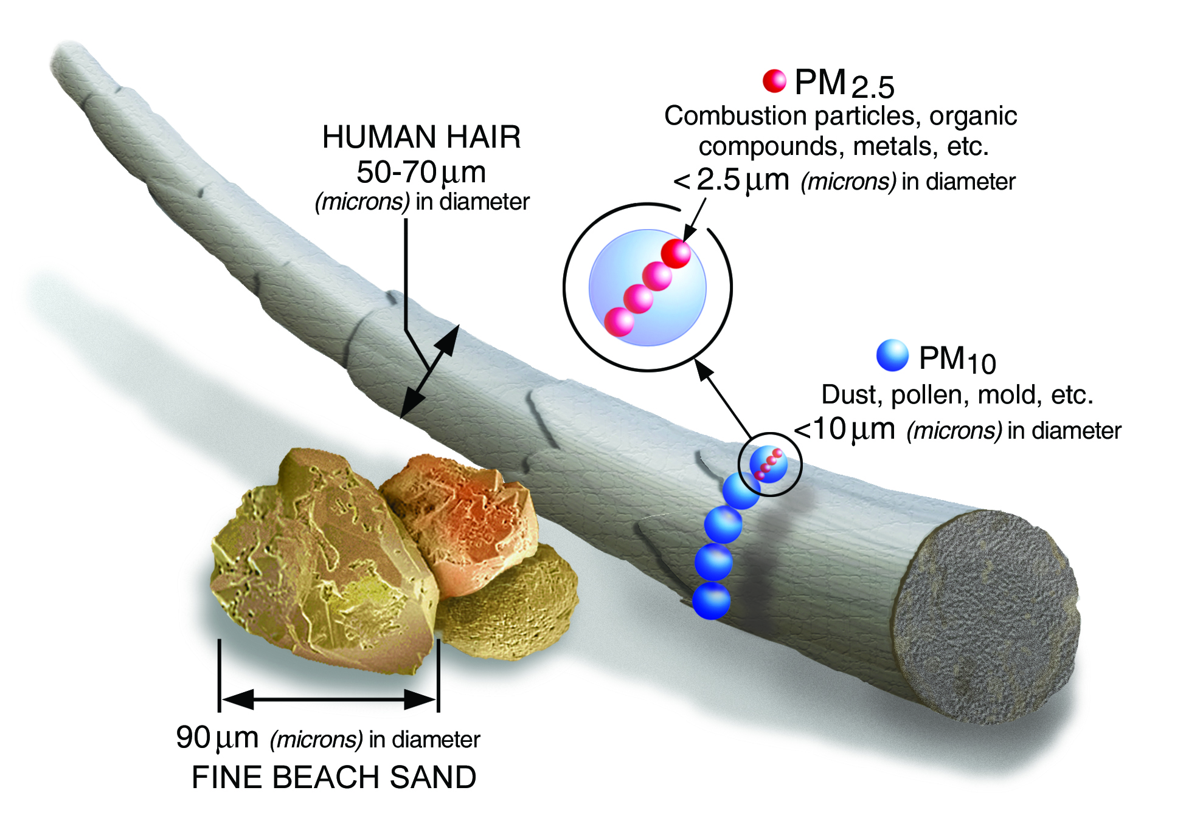
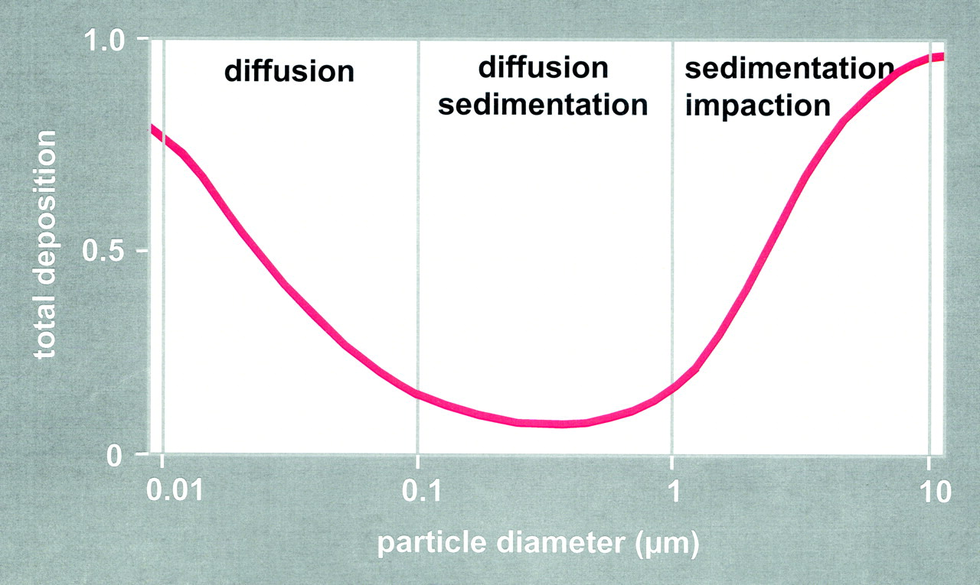
Hypothesis1: Ozone pollutions causes higher asthma rates as people living in polluted areas.
Ozone is a strong oxidant and exist in the gas phase.
Inhaled ozone interact with protein, lipids and can damage at cellular level.
O
O
Background ozone in clean environment = 20ppb
Polluted environment =40-60ppb.
17
O
Hypothesis 2: Particulate matter (PM2.5) is responsible for higher asthma rates.
UCSD Data visualization Bootcamp, DATA20180619
Notes:
Tropospheric ozone is a secondary pollutant, it is not emitted directly but instead is produced photochemically in the troposphere by its precursors such as reactive nitrogen oxide (NOx), CO, CH4 and VOC’s. Life time of an ozone molecule in the troposphere varies according to the photochemical activity ( a mean tropospheric life time is ~22days). Ozone has a longer life time in the free and cold troposphere than warmer boundary layer.
difference between stratospheric and tropospheric ozone generation is in the source of atomic O
for solar radiation with a wavelength of less than 242 nm:
O₂ + hv  O + O
photochemical production of O₃ in troposphere tied to NO_{x} (NO + NO₂)
for wavelengths less than 424 nm:
NO₂ + hv  NO + O
but NO will react with O₃
NO + O₃  NO₂
presence of peroxy radicals, from the oxidation of hydrocarbons, disturbs O₃-NO-NO₂ cycle
NO + HO₂·  NO₂ + OH·
NO + RO₂·  NO₂ + RO·
leads to net production of ozone
The ozone molecule has four resonance structure which imparts or confer a slight polarity to the ozone molecule (0.53D).
The bond length 1.272A is intermediate b/w double bond 1.21A and single bond (H-O) 1.47A {angstroms (A)}.
Protective shield in the stratosphere
Strong oxidant
Secondary pollutant in the troposphere
3rd most abundant GHG with RF +0.3 W.m-2
Damage crops and property
Cause respiratory diseases and premature mortality

Slide 10
Good Ozone in the Stratosphere
Protect from harmful UV radiations.
O + O2 + M → O3 + M
O₃
Bad Ozone in the Troposphere
hν
NO
NO₂
O₃
RO₂
HO₂
Notes:
Tropospheric ozone is a secondary pollutant, it is not emitted directly but instead is produced photochemically in the troposphere by its precursors such as reactive nitrogen oxide (NOx), CO, CH4 and VOC’s. Life time of an ozone molecule in the troposphere varies according to the photochemical activity ( a mean tropospheric life time is ~22days). Ozone has a longer life time in the free and cold troposphere than warmer boundary layer.
difference between stratospheric and tropospheric ozone generation is in the source of atomic O
for solar radiation with a wavelength of less than 242 nm:
O₂ + hv  O + O
photochemical production of O₃ in troposphere tied to NO_{x} (NO + NO₂)
for wavelengths less than 424 nm:
NO₂ + hv  NO + O
but NO will react with O₃
NO + O₃  NO₂
presence of peroxy radicals, from the oxidation of hydrocarbons, disturbs O₃-NO-NO₂ cycle
NO + HO₂·  NO₂ + OH·
NO + RO₂·  NO₂ + RO·
leads to net production of ozone
The ozone molecule has four resonance structure which imparts or confer a slight polarity to the ozone molecule (0.53D).
The bond length 1.272A is intermediate b/w double bond 1.21A and single bond (H-O) 1.47A {angstroms (A)}.
Protective shield in the stratosphere
Strong oxidant
Secondary pollutant in the troposphere
3rd most abundant GHG with RF +0.3 W.m-2
Damage crops and property
Cause respiratory diseases and premature mortality

